Slide 1

Georgetown Capstone Cohort 14
Booksville Team
Suchit Sharma, Elsa Abebe, Kamal Rangavajhula and Wesenyelew Sima

Slide 2




ROADMAP
Motivation and Hypothesis
Data Source
Data Ingest and Wrangling
Exploratory Data Analysis
Feature Selection
Model Evaluation
Result
Conclusion

Slide 3

The most unlikely places can spark an idea or curiosity

Slide 4

Amazon
Largest e-Commerce marketplace by revenue
> 50% products not sold by Amazon
Buy Box – The offer displayed on first page of the product
90% Sale goes to Buy Box

Slide 5

Hypothesis
Predict future sale price of a book based on historic Amazon sale data

Slide 6

Data Source
Data Collection Agency
Maintains price history of all products on Amazon
Based in Germany
Provides data via tokenized API

Slide 7
Architecture
Keepa
Product Sale History
PostgreSQL
Data Ingest
Psycopg2 / SQL
Data Wrangling
Pandas
Feature Selection
Scipy / Numpy / Scikit-learn
Model Evaluation
Scikit-learn / Math
Hyperparamerter Tuning
Scikit-learn
Reporting and Visulaization
Yellowbrick / Seaborn

Slide 8
Data Ingest
Challenge
Keepa API token bottleneck allowed only 1 or records per minute
API key set to expire within few weeks of obtaining it
Solution
We requested a data dump file from Keepa

Slide 9

Other Data Sources
Goodreads database
To match null Author values

Slide 10
Data Wrangling
Initial Data set:
100,192 records and 79 columns
No Price – Calculated using three columns
Removed columns with 50%+ null values
Replace categorical nulls with Unknown
Converted to appropriate data types
Dropped columns with no relevant information
Dropped columns with identical information as other columns.
Pre-EDA Data Set:
99,600 records and 49 columns

Slide 11
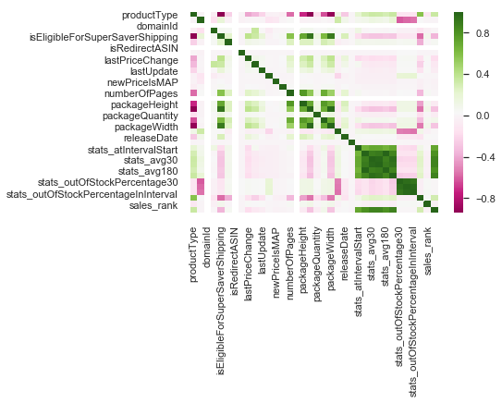
Exploratory Data Analysis
correlation Heatmap
Categorical Group Reduction
Identified categorical columns with long tail of unique but similar values
Replaced similar values (‘Middle English’) with superset values (‘English’)
Column values with < 10 frequency were grouped into ‘Others’
15 Categorical Columns encoded using LableEncoder
Outliers identified using Tukey’s fences and dropped

Slide 12
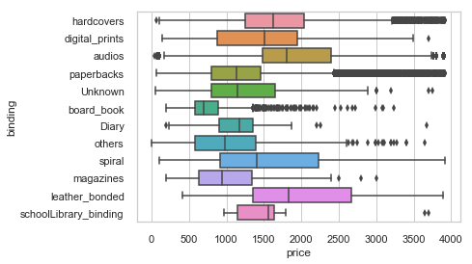
Exploratory Data Analysis
Binding Vs Price
Categorical Group Reduction
Identified categorical columns with long tail of unique but similar values
Replaced similar values (‘Middle English’) with superset values (‘English’)
Column values with < 10 frequency were grouped into ‘Others’
15 Categorical Columns encoded using LableEncoder
Outliers identified using Tukey’s fences and dropped

Slide 13
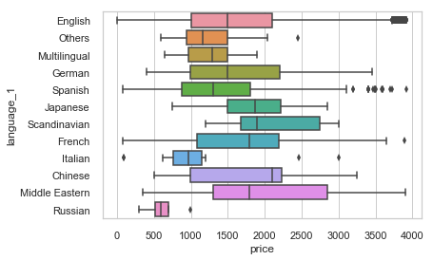
Exploratory Data Analysis
Language Vs Price
Categorical Group Reduction
Identified categorical columns with long tail of unique but similar values
Replaced similar values (‘Middle English’) with superset values (‘English’)
Column values with < 10 frequency were grouped into ‘Others’
15 Categorical Columns encoded using LableEncoder
Outliers identified using Tukey’s fences and dropped

Slide 14
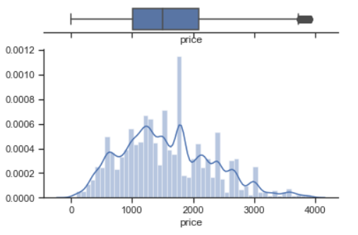
Feature selection
In
96,000 records; 49 features
Low variance features identified using VarianceThreshold method and dropped
Applied yellowbrick feature selection
Out
94,981 records; 37 features

Slide 15
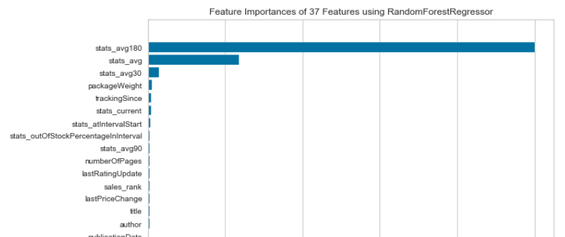
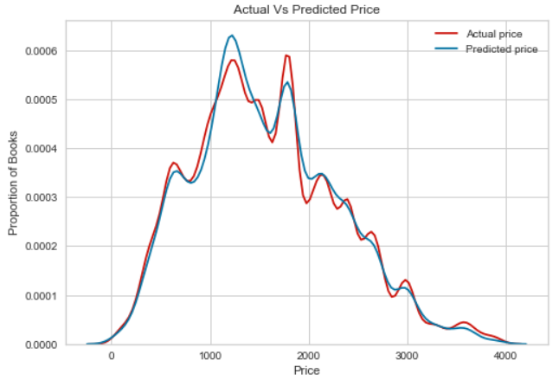
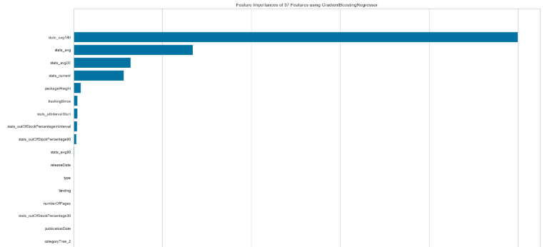
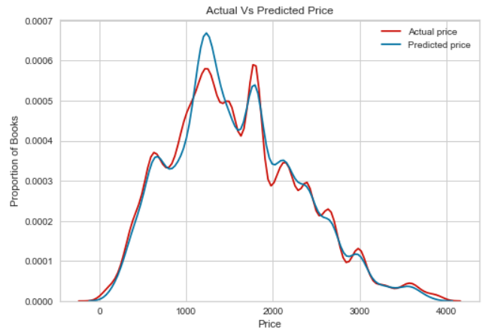
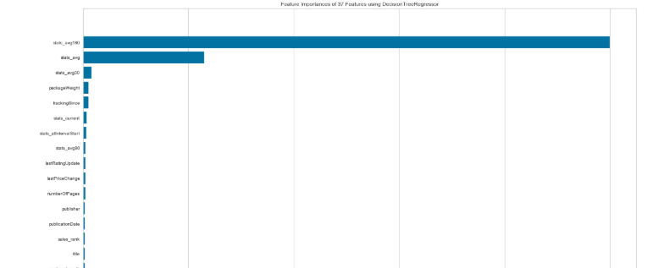
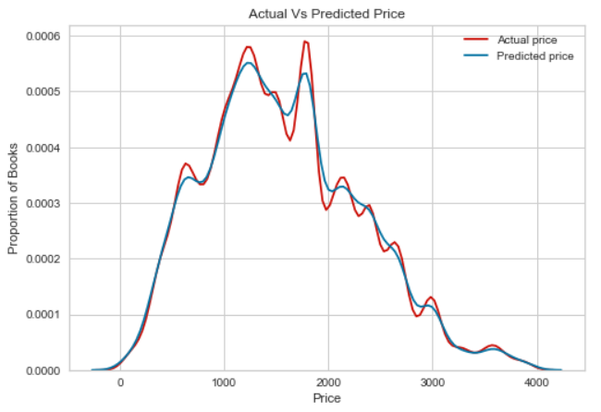
Feature Selection
Random Forest
Gradient Boosting
No
Features
Dropped
Decision Tree

Slide 16

Model Evaluation
Scikit-learn Model Selection
Accuracy & MSE
Yellowbrick Residuals
Cross
Validation
Yellowbrick Validation Curve
Models Tested
GradientBoostingRegressor
RandomForestRegressor
DecisionTreeRegressor
LinearRegression
MLPRegressor
RidgeCV
LassoLars
Lasso
ElasticNet
BayesianRidge
RANSACRegressor
Models Shortlisted
GradientBoostingRegressor
RandomForestRegressor
DecisionTreeRegressor

Slide 17
Accuracy Score and RMSE
Model | Accuracy Score | RMSE (Root Mean Squared Error)
Gradient Boost | 0.9367 | 186.892
Random Forest | 0.9337 | 191.185
Decision Tree | 0.8823 | 254.817
Lasso | 0.8548 | 283.051
Elastic Search | 0.8502 | 287.564
LassoLars | 0.6205 | 457.734
Linear Regression | 0.3394 | 603.907
Ransac | negative | 2.89 M
MLP | negative | 3.666 M
Bayesian Ridge | negative | 62.41 K
Ridge CV | negative | Very High

Slide 18
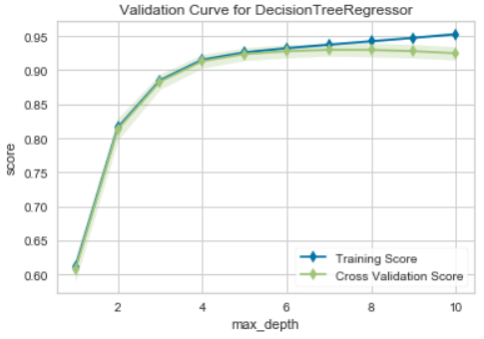
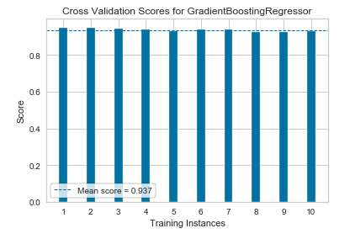
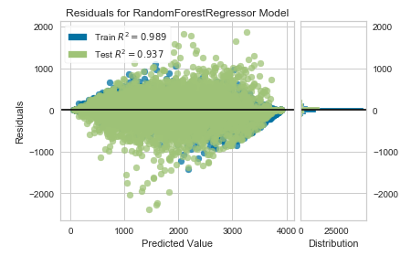
Model Evaluation Cont.

Slide 19
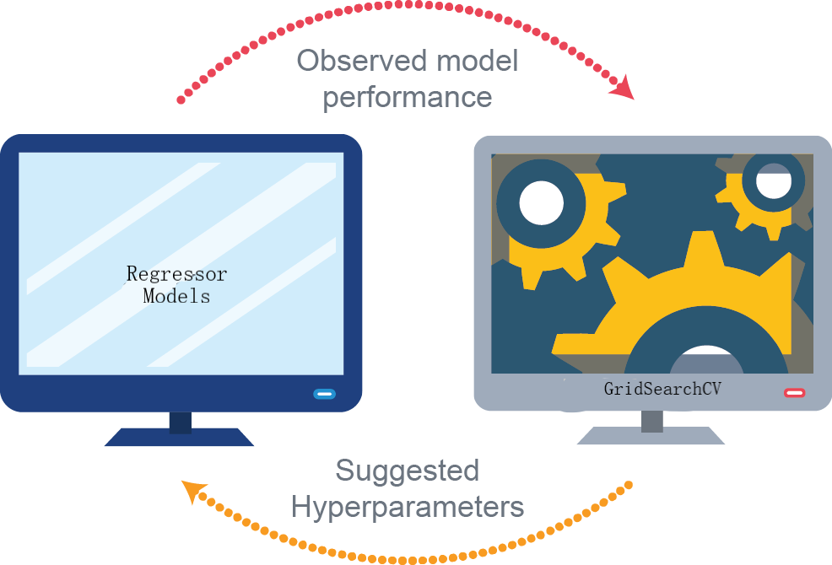
Hyperparameter Tuning Scikit-learn GridSearchCV
Model | Accuracy | HPT Accuracy
Decision Tree Regressor | 0.879 | 0.928
Gradient Boosting Regressor | 0.937 | 0.939
Random Forest Regressor | 0.936 | 0.940

Slide 20

Result
Random
Forest
Gradient
Boosting
Decision
Tree
0.939
0.940
0.928

Slide 21
Conclusion
It is possible to predict sale price of a book with a high degree of accuracy if healthy sale history is available
As the sale history deprecates, prediction accuracy deprecates along with it
Amazon genius is in how they capture a multitude of sale points into a set of statistical features.

Slide 22

Questions

Slide 23


